Slide 1
Business Process Support
Le Tung Duong - BH00501
Class: IT0602
Lecturers: Dinh Van Dong

Slide 2
Content
P1: DISCUSS HOW DATA AND INFORMATION SUPPORT BUSINESS PROCESSES, INCLUDING THE VALUE THEY BRING TO THE ORGANIZATION.
P2: DISCUSSION OF HOW DATA IS GENERATED AND USED BY ORGANISATIONS TO SUPPORT BUSINESS PROCESSES AND THE TOOLS FOR MANIPULATION TO FORM MEANINGFUL DATA
M1: ASSESS THE VALUE OF DATA AND INFORMATION TO INDIVIDUALS AND ORGANIZATIONS IN RELATION TO REAL-WORLD BUSINESS PROCESSES

Slide 3
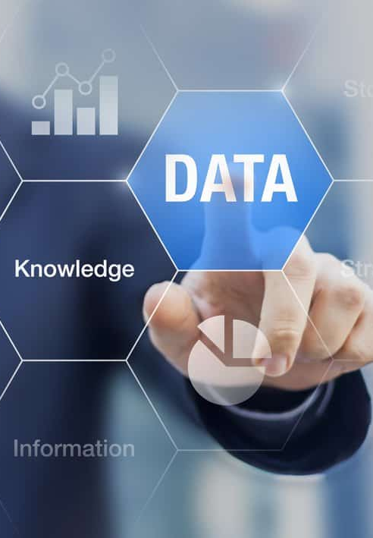
P1: DISCUSS HOW DATA AND INFORMATION SUPPORT BUSINESS PROCESSES, INCLUDING THE VALUE THEY BRING TO THE ORGANIZATION.

Slide 4
P1: DISCUSS HOW DATA AND INFORMATION SUPPORT BUSINESS PROCESSES, INCLUDING THE VALUE THEY BRING TO THE ORGANIZATION.
Data and information are indispensable assets for modern organizations, enabling them to make informed decisions, improve efficiency, enhance customer experience, manage risks, gain competitive advantage, generate revenue, and maintain compliance with regulatory requirements.
Data and information play a crucial role in supporting business processes and driving value for organizations in various ways:
1. Informed Decision-Making
2. Efficiency and Productivity
3. Enhanced Customer Experience
4. Risk Management
5. Competitive Advantage
6. Revenue Generation
7. Compliance and Governance

Slide 5
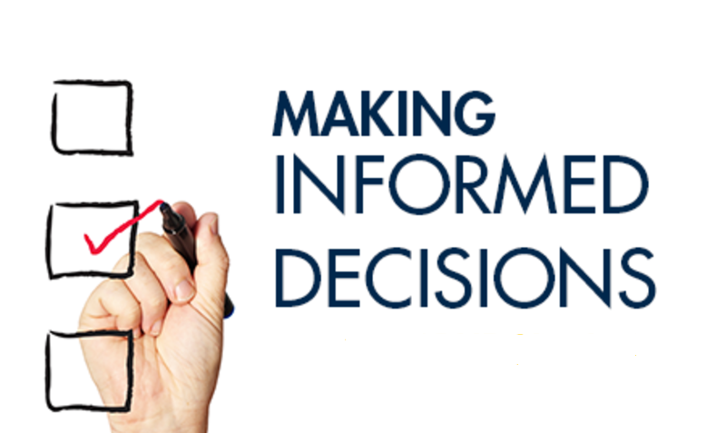
1. Informed Decision-Making
Data and information provide the foundation for informed decision-making within organizations. By analyzing relevant data, businesses can gain insights into market trends, customer behavior, and internal operations, allowing them to make strategic decisions that can positively impact their performance and profitability.

Slide 6

1. Informed Decision-Making
Example: A retail chain analyzes sales data from different store locations to identify which products are performing well in specific regions. Based on this information, they decide to stock more of the popular items in stores with high demand, optimizing inventory management and increasing overall sales.

Slide 7
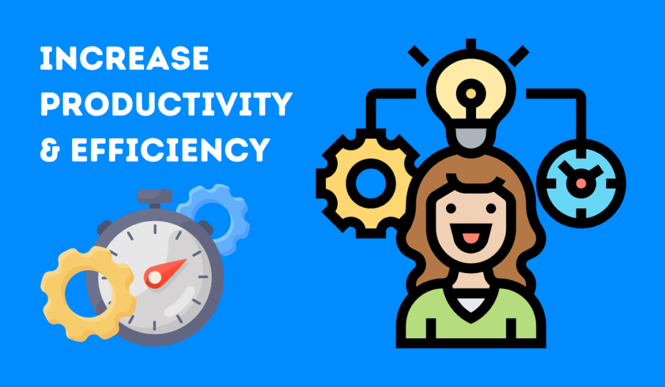
2. Efficiency and Productivity
Access to accurate and timely information enables businesses to streamline their processes and improve operational efficiency. For example, automated data collection and analysis tools can help identify bottlenecks in production processes, allowing organizations to optimize workflows and allocate resources more effectively.

Slide 8

2. Efficiency and Productivity
Example: An e-commerce company uses data analytics to track website traffic and user behavior. By analyzing this data, they identify pages with high bounce rates and optimize them for better user engagement, leading to increased conversion rates and improved website efficiency.

Slide 9
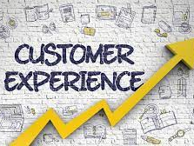
3. Enhanced Customer Experience
Understanding customer preferences and behavior through data analysis enables organizations to tailor their products and services to better meet customer needs. By leveraging customer data, businesses can personalize marketing efforts, improve customer service, and develop products that resonate with their target audience, ultimately leading to increased customer satisfaction and loyalty.

Slide 10
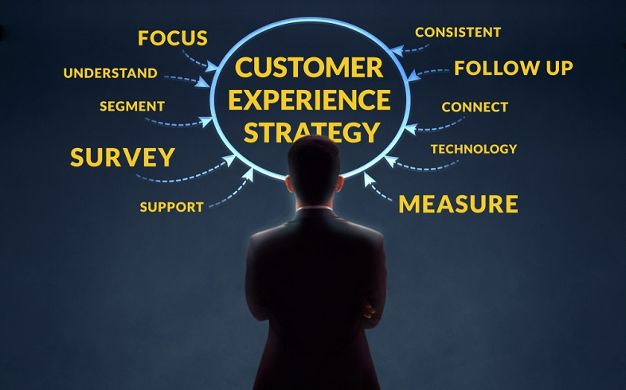
3. Enhanced Customer Experience
Example: A telecommunications company analyzes customer service call logs to identify common issues and pain points faced by customers. Based on this information, they implement self-service options and proactive customer support initiatives, reducing wait times and improving overall customer satisfaction.

Slide 11

4. Risk Management
Data and information are essential for assessing and managing risks within organizations. By monitoring relevant data points, businesses can identify potential risks such as cybersecurity threats, market volatility, or supply chain disruptions, and implement proactive measures to mitigate these risks before they escalate into larger problems.

Slide 12
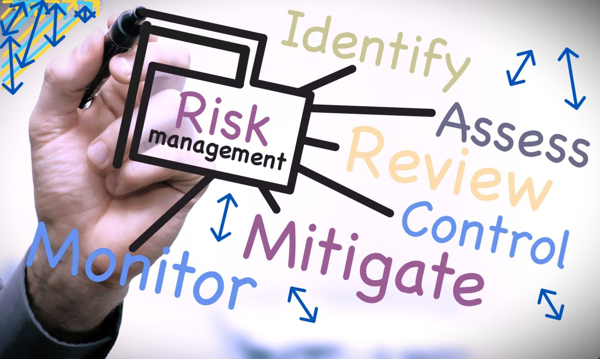
4. Risk Management
Example: A financial institution utilizes predictive analytics to assess credit risk for loan applicants. By analyzing historical data on borrower behavior and economic indicators, they identify applicants with a higher likelihood of default and adjust lending criteria accordingly, reducing the risk of loan defaults and financial losses.

Slide 13
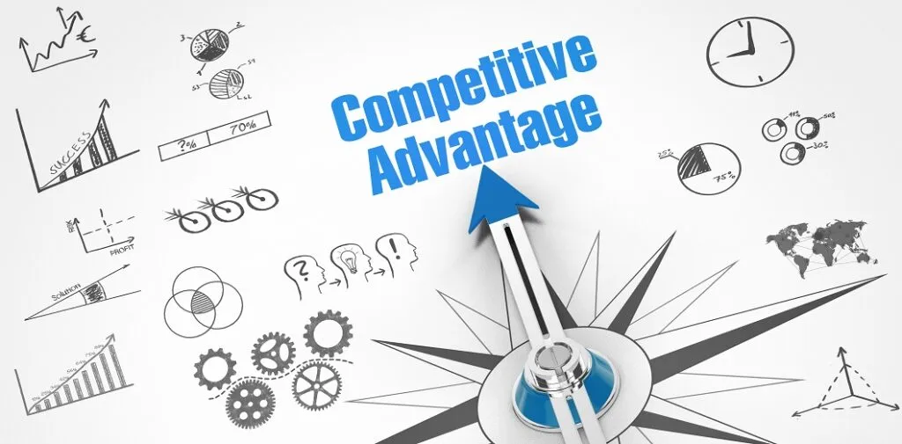
5. Competitive Advantage
In today's competitive business landscape, organizations that effectively harness data and information gain a significant competitive advantage. By leveraging data analytics and market intelligence, businesses can identify opportunities for innovation, anticipate market trends, and stay ahead of competitors.

Slide 14

5. Competitive Advantage
Example: A hospitality chain utilizes big data analytics to analyze guest preferences and booking patterns. By leveraging this information, they personalize marketing campaigns and loyalty programs to target specific customer segments effectively, gaining a competitive edge in the market and increasing customer loyalty.

Slide 15
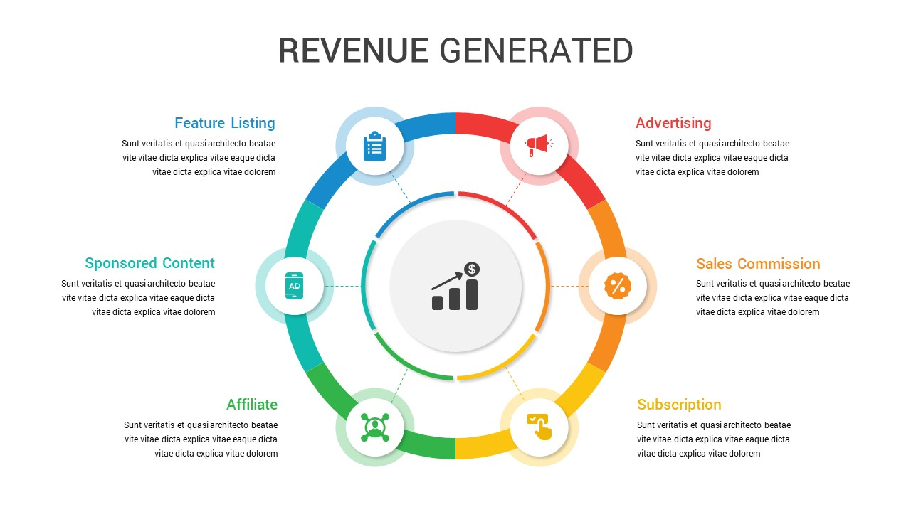
6. Revenue Generation
Data-driven insights can uncover new revenue streams and business opportunities for organizations. By analyzing customer data, businesses can identify cross-selling or upselling opportunities, optimize pricing strategies, and develop targeted marketing campaigns to drive sales and revenue growth.

Slide 16
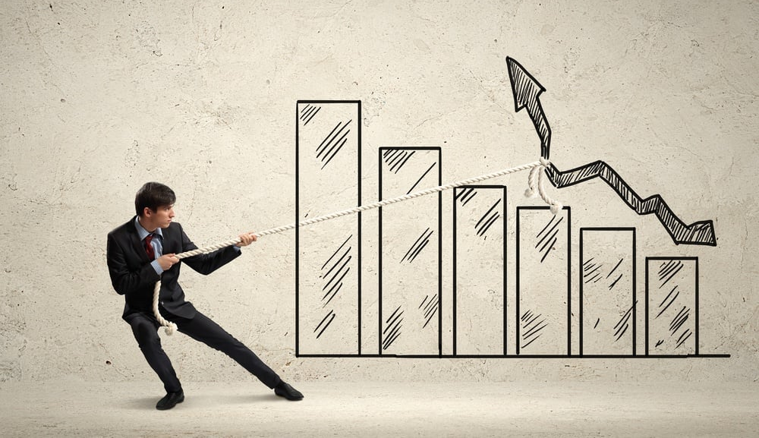
6. Revenue Generation
Example: An online streaming platform analyzes viewer data to identify popular content genres and viewing habits. Based on this insight, they acquire or produce content tailored to audience preferences, attracting more subscribers and increasing revenue through subscription fees and advertising.

Slide 17
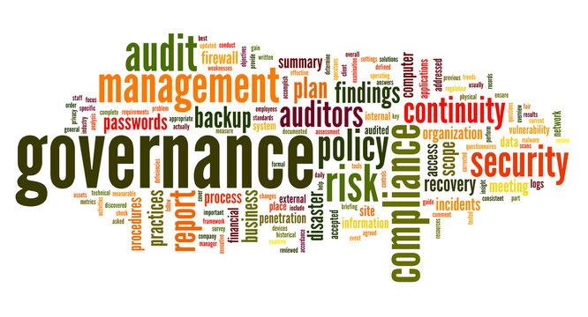
7. Compliance and Governance
In many industries, compliance with regulatory requirements and adherence to data governance standards are critical for maintaining trust and credibility with customers, partners, and stakeholders. Proper data management practices ensure that organizations comply with relevant regulations and protect sensitive information, reducing the risk of legal and reputational damage.

Slide 18

7. Compliance and Governance
Example: A healthcare organization implements robust data security measures and compliance protocols to protect patient confidentiality and comply with regulations such as the Health Insurance Portability and Accountability Act (HIPAA). By ensuring data privacy and security, they maintain patient trust and avoid costly penalties for non-compliance.

Slide 19
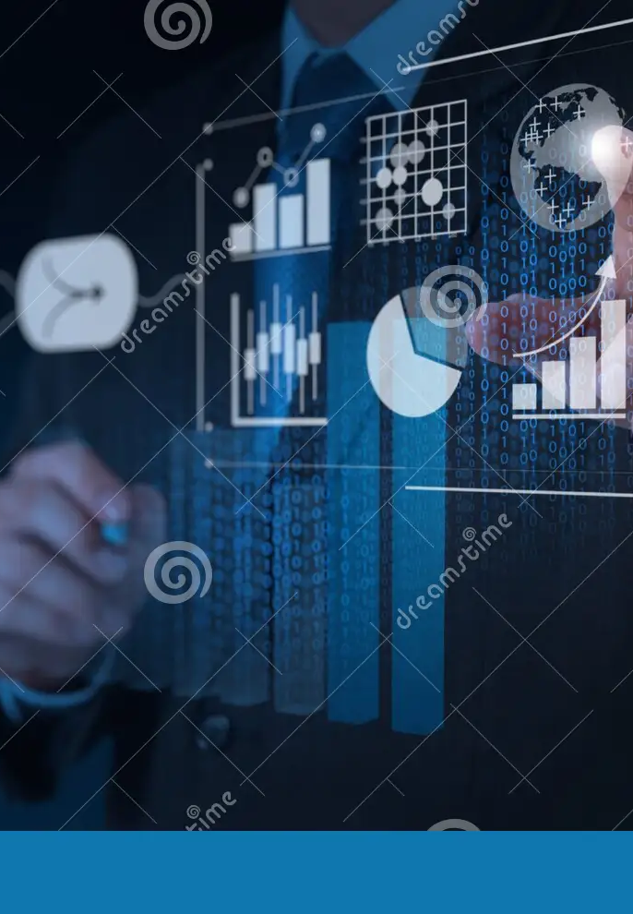
P2: DISCUSSION OF HOW DATA IS GENERATED AND USED BY ORGANISATIONS TO SUPPORT BUSINESS PROCESSES AND THE TOOLS FOR MANIPULATION TO FORM MEANINGFUL DATA

Slide 20
P2: DISCUSSION OF HOW DATA IS GENERATED AND USED BY ORGANISATIONS TO SUPPORT BUSINESS PROCESSES AND THE TOOLS FOR MANIPULATION TO FORM MEANINGFUL DATA
Data is generated and used by organizations across various business processes to make informed decisions, improve efficiency, enhance customer experience, manage risks, and gain competitive advantage. Here's a discussion of how data is generated and utilized, along with the tools for manipulating data to form meaningful insights:
1. Data Generation
2. Data Utilization
3. Tools for Data Manipulation

Slide 21
1. Data Generation
Internal Sources: Organizations generate data through internal sources such as ERP (Enterprise Resource Planning), CRM (Customer Relationship Management), HRIS (Human Resources Information Systems), and financial databases. These systems record transactions, interactions with customers, employee information, financial records, and more.
External Sources: Data is also generated from external sources including market research reports, social media platforms, web analytics, IoT (Internet of Things) sensors, and third-party data providers. External data provides insights into market trends, consumer behavior, competitor activities, and industry benchmarks.

Slide 22
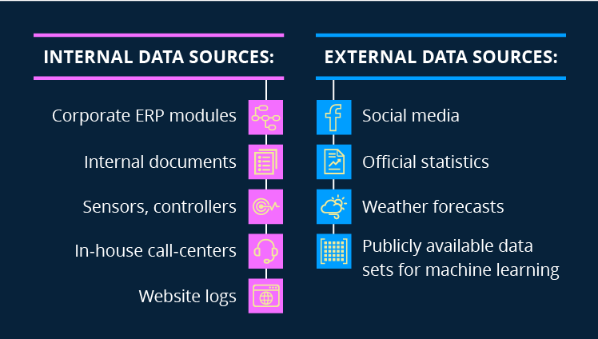
Internal Sources and External Sources

Slide 23
2. Data Utilization
- Decision Making: Organizations utilize data to make strategic decisions across all levels, from operational to executive. Data-driven decision-making involves analyzing historical data, predicting future trends, and identifying opportunities and risks.
- Process Improvement: Data is used to optimize business processes and improve operational efficiency. By analyzing process data, organizations can identify bottlenecks, streamline workflows, and automate repetitive tasks.
- Customer Experience: Data analysis helps organizations understand customer preferences, behavior, and sentiment. By leveraging customer data, businesses can personalize marketing efforts, tailor products and services, and provide better customer support.
- Risk Management: Data is crucial for identifying and mitigating risks such as cybersecurity threats, financial fraud, supply chain disruptions, and regulatory compliance issues. Risk analysis tools help organizations assess the likelihood and impact of risks and implement appropriate controls.
- Competitive Intelligence: Organizations use data to gain insights into competitor activities, market trends, and emerging opportunities. Competitive analysis tools provide real-time information on competitor pricing, product features, marketing strategies, and customer feedback.

Slide 24
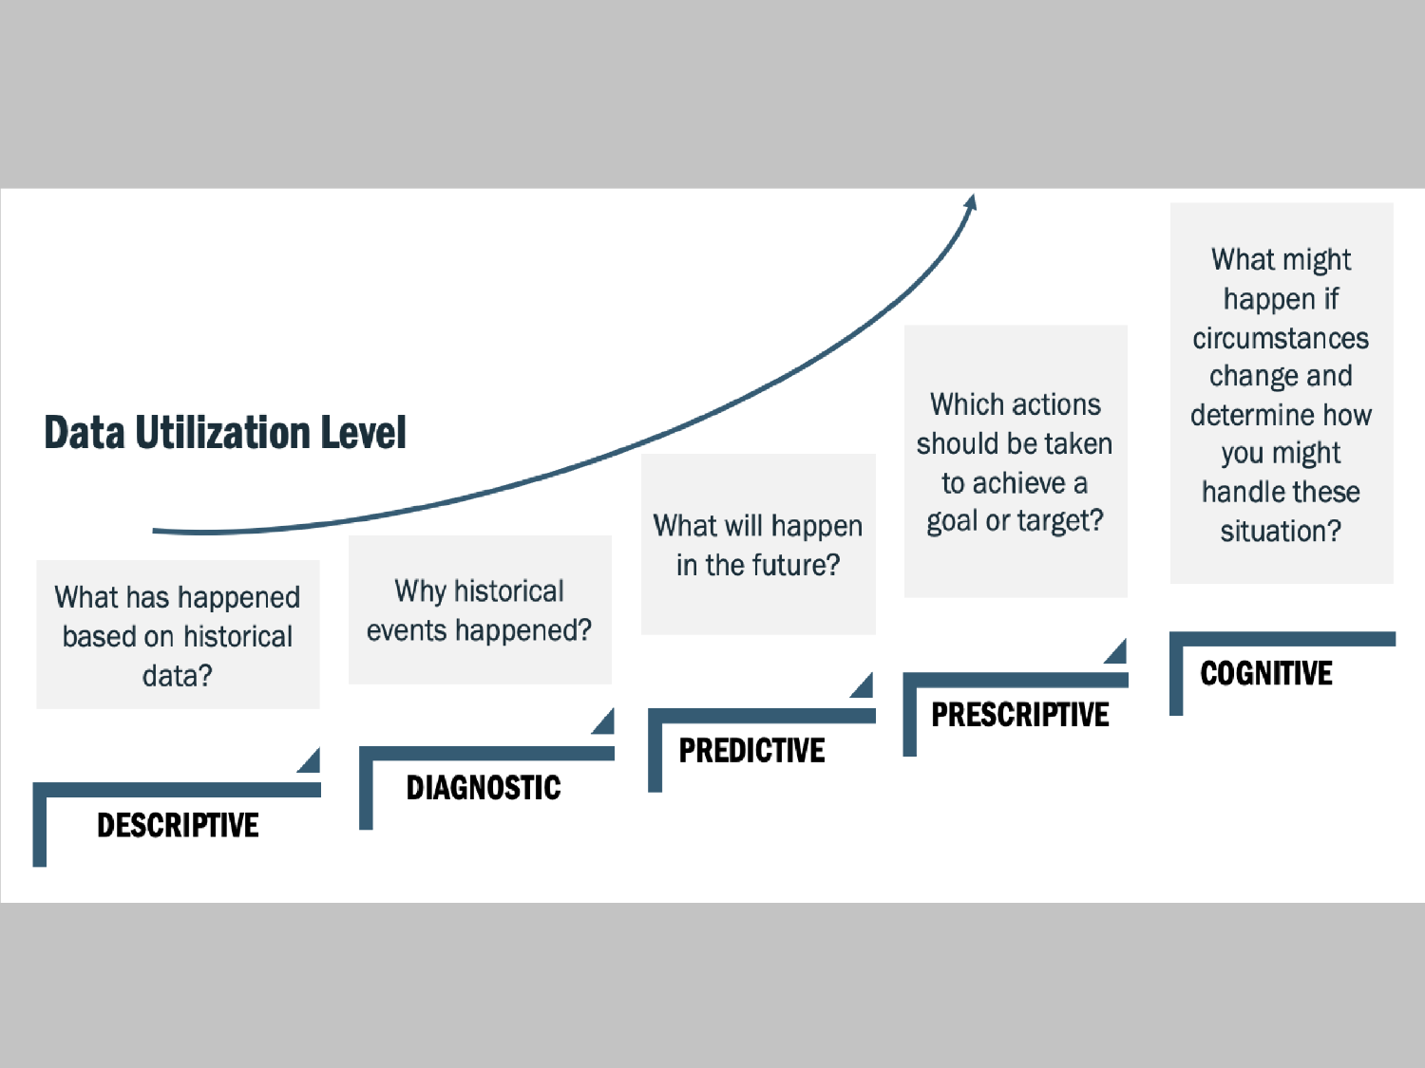
2. Data Utilization

Slide 25
3. Tools for Data Manipulation
- Data Integration Tools: Tools like ETL (Extract, Transform, Load) software help organizations integrate data from multiple sources into a centralized repository. This allows for seamless access and analysis of heterogeneous data.
- Data Cleaning and Preparation Tools: Data cleaning tools help organizations identify and correct errors, duplicates, and inconsistencies in the data. These tools automate the process of data cleansing, saving time and ensuring data accuracy.
- Data Analytics Platforms: Analytics platforms provide advanced analytical capabilities for exploring, visualizing, and analyzing data. These platforms support a wide range of analytics techniques, including descriptive, diagnostic, predictive, and prescriptive analytics.
- Business Intelligence (BI) Tools: BI tools enable organizations to create interactive dashboards, reports, and data visualizations. These tools help stakeholders gain actionable insights from data and monitor key performance indicators (KPIs) in real-time.
- Machine Learning and AI: Machine learning algorithms and AI-powered analytics tools help organizations uncover complex patterns and relationships in data. These tools enable predictive modeling, anomaly detection, and automated decision-making based on data-driven insights.

Slide 26
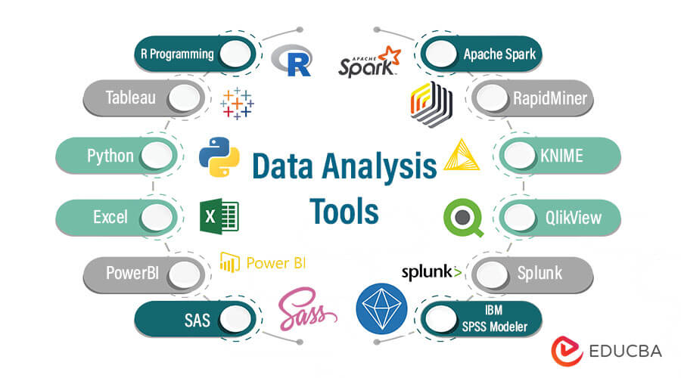
Some Tools for Data Manipulation

Slide 27
M1: ASSESS THE VALUE OF DATA AND INFORMATION TO INDIVIDUALS AND ORGANIZATIONS IN RELATION TO REAL-WORLD BUSINESS PROCESSES

Slide 28
M1: ASSESS THE VALUE OF DATA AND INFORMATION TO INDIVIDUALS AND ORGANIZATIONS IN RELATION TO REAL-WORLD BUSINESS PROCESSES
Data and information are invaluable assets that empower individuals and organizations to optimize business processes, enhance customer experiences, drive innovation, manage risks, gain competitive advantage, and achieve sustainable growth in today's rapidly evolving business environment.
The value of data and information to both individuals and organizations in real-world business processes cannot be overstated. Here's a comprehensive assessment of their value:
1. Informed Decision-Making
2. Operational Efficiency
3. Customer Insights and Personalization
4. Innovation and Product Development
5. Risk Management and Compliance
6. Competitive Advantage
7. Revenue Growth and Business Expansion

Slide 29
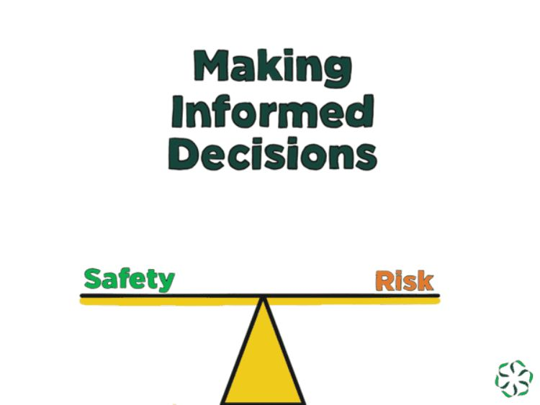
1. Informed Decision-Making
Data and information provide the foundation for informed decision-making at all levels of an organization. Whether it's executives strategizing for the future, managers optimizing operations, or frontline employees interacting with customers, access to relevant data enables individuals to make smarter, more effective decisions that drive business success.

Slide 30
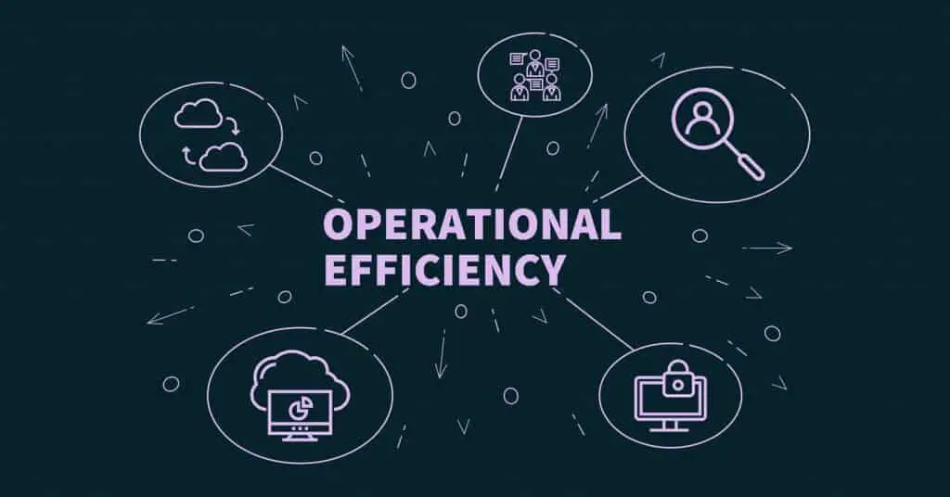
2. Operational Efficiency
Data and information help streamline business processes and improve operational efficiency. By analyzing data on workflow performance, resource utilization, and bottlenecks, organizations can identify areas for optimization, automate repetitive tasks, and allocate resources more effectively, leading to cost savings and productivity gains.

Slide 31
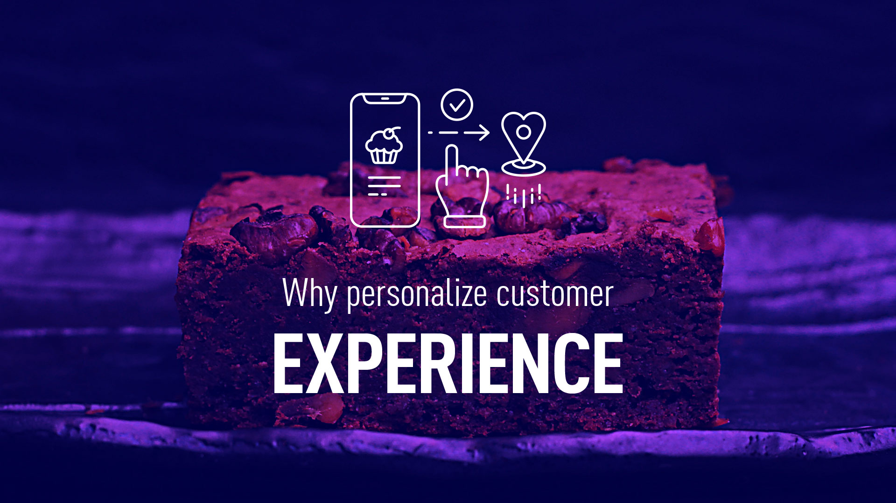
3. Customer Insights and Personalization
Data and information allow organizations to gain deep insights into customer behavior, preferences, and needs. By analyzing customer data from various sources, including transactions, interactions, and feedback, businesses can tailor their products, services, and marketing efforts to better meet individual customer needs, enhancing customer satisfaction and loyalty.

Slide 32
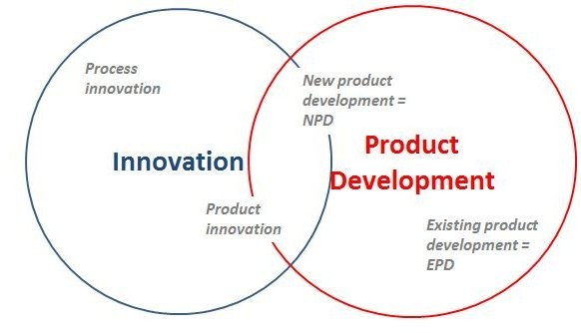
4. Innovation and Product Development
Data-driven insights drive innovation and inform product development strategies. By analyzing market trends, competitor offerings, and customer feedback, organizations can identify gaps in the market and develop innovative solutions that address unmet needs, driving competitive differentiation and fostering business growth.

Slide 33
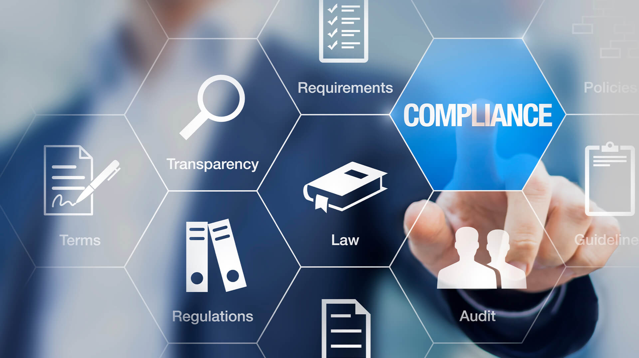
5. Risk Management and Compliance
Data and information are essential for identifying, assessing, and mitigating risks within organizations. Whether it's financial risks, cybersecurity threats, or regulatory compliance requirements, access to timely and accurate data enables organizations to proactively manage risks, protect assets, and ensure compliance with relevant laws and regulations.

Slide 34
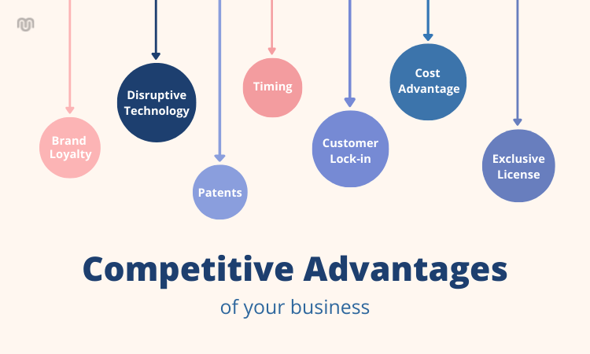
6. Competitive Advantage
In today's competitive business landscape, organizations that effectively leverage data and information gain a significant competitive advantage. By harnessing advanced analytics, machine learning, and artificial intelligence technologies, businesses can gain deeper insights into market dynamics, competitor strategies, and customer preferences, enabling them to make faster, more informed decisions and stay ahead of the competition.

Slide 35
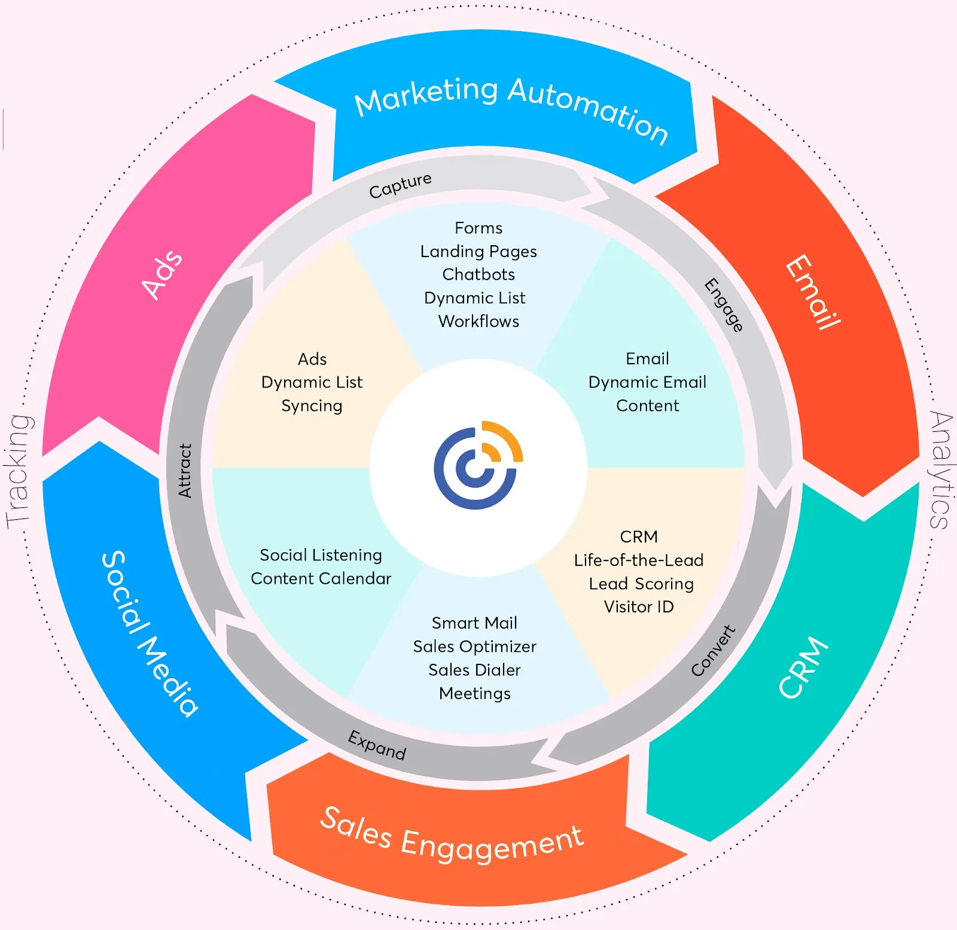
7. Revenue Growth and Business Expansion
Data and information drive revenue growth and support business expansion initiatives. By identifying new market opportunities, optimizing pricing strategies, and targeting high-value customer segments, organizations can drive sales growth, expand their market presence, and increase profitability, fueling long-term business success and sustainability.

Slide 36


Thank you for WAtching And Listening to my presentation

